Slide 1
STORY TELLING WITH TABLEAU
Marketing is the study and management of exchange relationships. Marketing is the business process of creating relationships with and satisfying customers.
Analytics
4 Components
4.3/ Reporting Period
1
To get your company’s name out there, you need to make sure.
4
To get your company’s name out there, you need to make sure.
7
To get your company’s name out there, you need to make sure.
METRIC & KPI
4.1/ Business Context
4.4/ Story with Data
2
To get your company’s name out there, you need to make sure.
5
To get your company’s name out there, you need to make sure.
8
To get your company’s name out there, you need to make sure.
3
LAG & LEAD METRIC
6
4.2/ Stakeholders
9
Data Manipulation
To get your company’s name out there, you need to make sure.
To get your company’s name out there, you need to make sure.
To get your company’s name out there, you need to make sure.

Slide 2
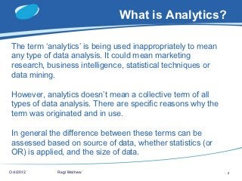
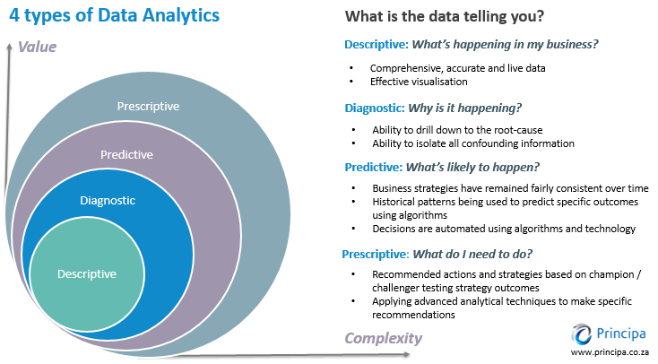
ANALYTICS
Placing your charts can make the difference in getting your story right or getting your stake holders to take action

Slide 3

METRIC & KPI
Metric and KPI’s are the language of Business
VS
METRIC
KPI
Measure the performance of different functions of a business
Measure the progress of the most important objectives of the business
Usually have an industry benchmark
Usually set by the company based on the objectives(s)
Driven by a tactic, an individual, and/or a small group in a team
Driven by multiple strategies and metrics (sometimes cross-team) in a company

Slide 4
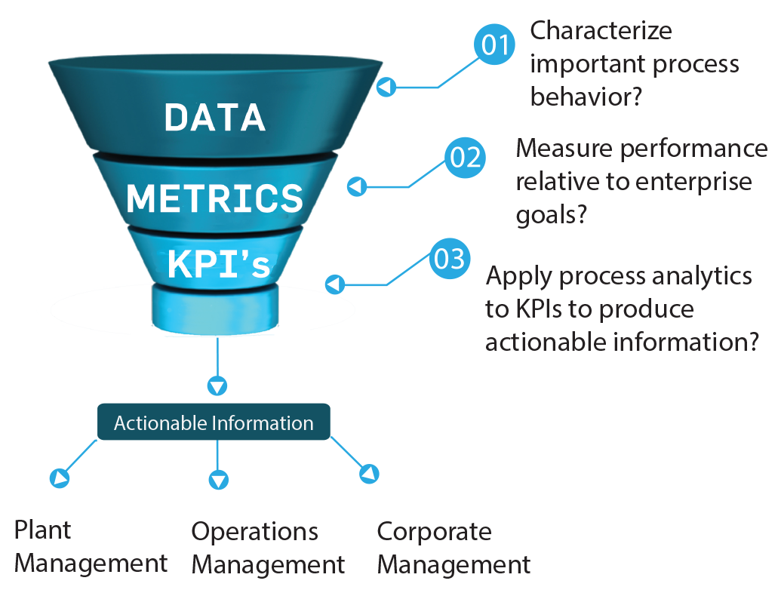
METRIC & KPI
Placing your charts can make the difference in getting your story right or getting your stake holders to take action

Slide 5
LAG & LEAD METRIC
Placing your charts can make the difference in getting your story right or getting your stake holders to take action

Slide 6
4 Components
Placing your charts can make the difference in getting your story right or getting your stake holders to take action

Slide 7
4.1/ Business Context
Placing your charts can make the difference in getting your story right or getting your stake holders to take action

Slide 8
4.2/ Stakeholders
Placing your charts can make the difference in getting your story right or getting your stake holders to take action

Slide 9
4.3/ Reporting Period
Placing your charts can make the difference in getting your story right or getting your stake holders to take action

Slide 10
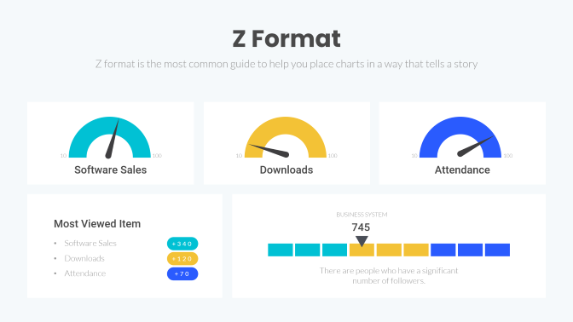
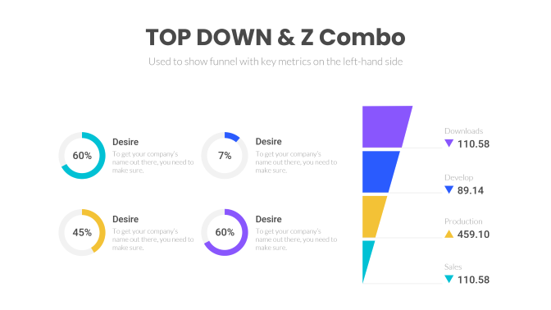
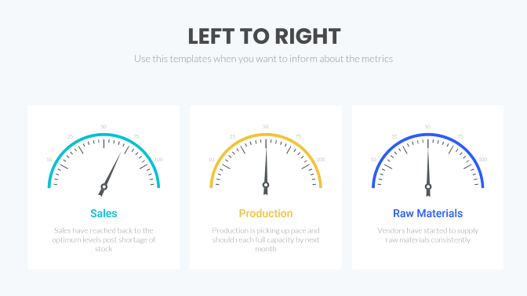
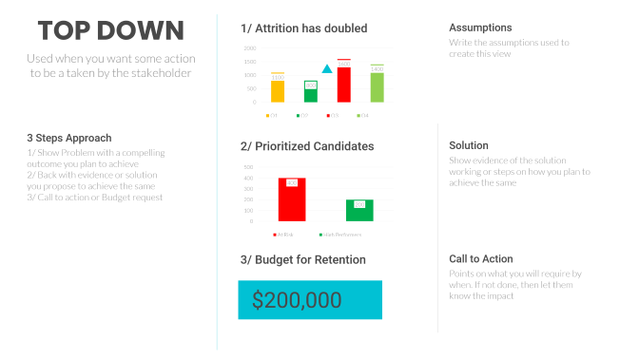
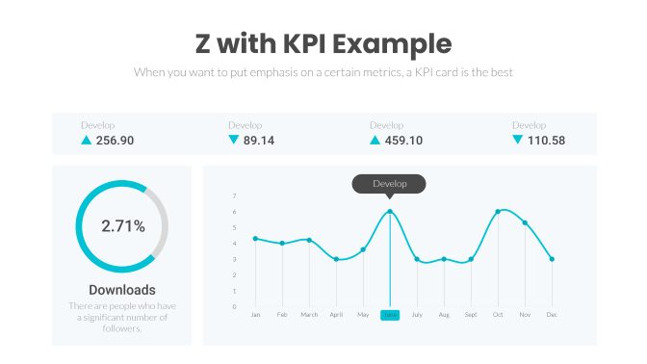
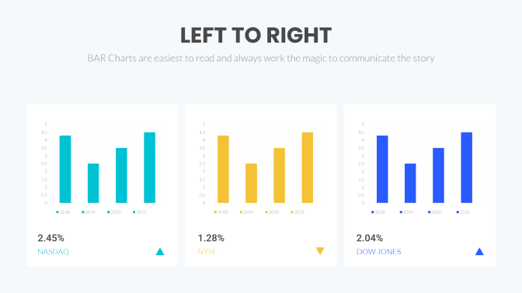
4.4/ Story with Data
Placing your charts can make the difference in getting your story right or getting your stake holders to take action

Slide 11
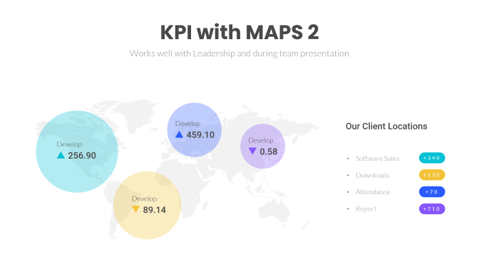
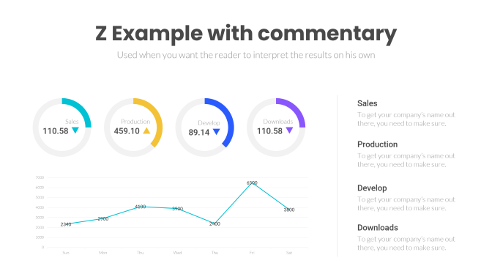
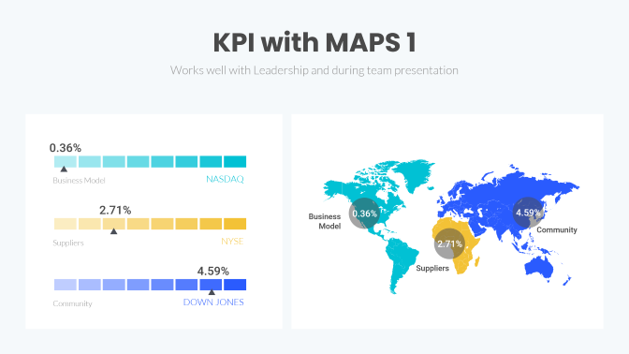
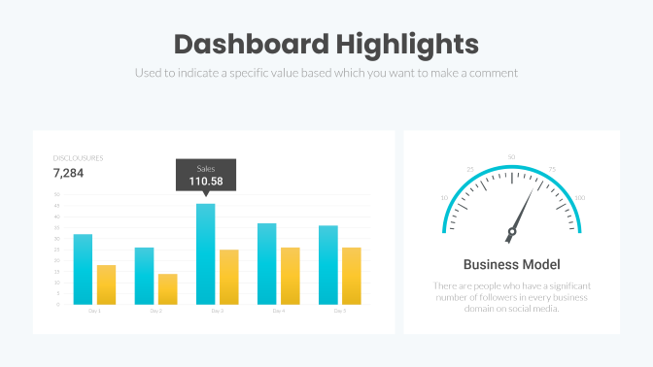
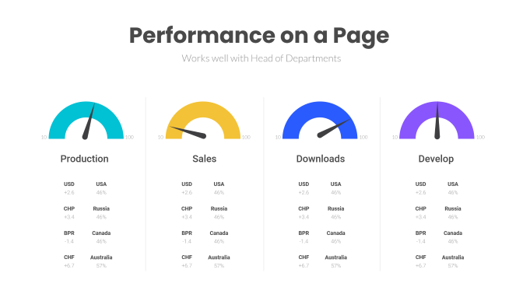
4.4/ Others
These formats also work best with a certain audience

Slide 12
Z Format
Z format is the most common guide to help you place charts in a way that tells a story
10
100
10
100
10
100
Software Sales
Downloads
Attendance
BUSINESS SYSTEM
Most Viewed Item
745
Software Sales
Downloads
Attendance
+340
+120
+70
There are people who have a significant number of followers.

Slide 13
Z with KPI Example
When you want to put emphasis on a certain metrics, a KPI card is the best
Develop
Develop
Develop
Develop
256.90
89.14
459.10
110.58
Develop
2.71%
Downloads
There are people who have a significant number of followers.

Slide 14
Z Example with commentary
Used when you want the reader to interpret the results on his own
Sales
To get your company’s name out there, you need to make sure.
Sales
Production
Develop
Downloads
110.58
459.10
89.14
110.58
Production
To get your company’s name out there, you need to make sure.
Develop
To get your company’s name out there, you need to make sure.
Downloads
To get your company’s name out there, you need to make sure.

Slide 15
Dashboard Highlights
Used to indicate a specific value based which you want to make a comment
DISCLOUSURES
50
7,284
Sales
25
75
110.58
10
100
Business Model
There are people who have a significant number of followers in every business domain on social media.

Slide 16
LEFT TO RIGHT
Use this templates when you want to inform about the metrics
50
50
50
25
75
25
75
25
75
10
100
10
100
10
100
Sales
Production
Raw Materials
Sales have reached back to the optimum levels post shortage of stock
Production is picking up pace and should reach full capacity by next month
Vendors have started to supply raw materials consistently

Slide 17
LEFT TO RIGHT
BAR Charts are easiest to read and always work the magic to communicate the story
2.45%
1.28%
2.04%
NASDAQ
NYSE
DOW JONES

Slide 18
TOP DOWN
1/ Attrition has doubled
Assumptions
Write the assumptions used to create this view
Used when you want some action to be a taken by the stakeholder
3 Steps Approach
2/ Prioritized Candidates
Solution
1/ Show Problem with a compelling outcome you plan to achieve
2/ Back with evidence or solution you propose to achieve the same
3/ Call to action or Budget request
Show evidence of the solution working or steps on how you plan to achieve the same
3/ Budget for Retention
Call to Action
Points on what you will require by when. If not done, then let them know the impact
$200,000

Slide 19
TOP DOWN & Z Combo
Used to show funnel with key metrics on the left-hand side
Downloads
Desire
Desire
110.58
60%
To get your company’s name out there, you need to make sure.
7%
To get your company’s name out there, you need to make sure.
Develop
89.14
Desire
Desire
Production
45%
To get your company’s name out there, you need to make sure.
60%
To get your company’s name out there, you need to make sure.
459.10
Sales
110.58

Slide 20
Performance on a Page
Works well with Head of Departments
10
100
10
100
10
100
10
100
Production
Sales
Downloads
Develop
USD
USA
USD
USA
USD
USA
USD
USA
+2.6
46%
+2.6
46%
+2.6
46%
+2.6
46%
CHP
Russia
CHP
Russia
CHP
Russia
CHP
Russia
+3.4
46%
+3.4
46%
+3.4
46%
+3.4
46%
BPR
Canada
BPR
Canada
BPR
Canada
BPR
Canada
-1.4
46%
-1.4
46%
-1.4
46%
-1.4
46%
CHF
Australia
CHF
Australia
CHF
Australia
CHF
Australia
+6.7
57%
+6.7
57%
+6.7
57%
+6.7
57%

Slide 21
KPI with MAPS 1
Works well with Leadership and during team presentation
0.36%
Business Model
NASDAQ
2.71%
0.36%
4.59%
Business Model
Community
Suppliers
NYSE
2.71%
4.59%
Suppliers
Community
DOWN JONES

Slide 22
KPI with MAPS 2
Works well with Leadership and during team presentation
Develop
Our Client Locations
459.10
Develop
Develop
256.90
0.58
Software Sales
Downloads
Attendance
Report
+340
+120
Develop
+70
89.14
+710

